Slide 1
GLOBAL NEXT CONSULTING INDIA PRIVATE LIMITED
Data Analytics Week-6 Project
Worked by - ROJINA KHATUN & PRAJNA MONDAL
Project Title - Employment Data Analysis and Skill Gap Identification

Slide 2
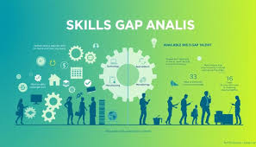
Project Objective
Analyze employment data to identify current and future skill gaps in the workforce.

Slide 3
Introduction
In today’s rapidly evolving job market, the demand for skilled professionals is continuously changing due to technological advancements, automation, and shifting industry requirements. As a result, many organizations face difficulties in finding candidates with the right skills, while job seekers often struggle to match current market expectations. This mismatch between job requirements and workforce capabilities leads to skill gaps that affect productivity and economic growth.
The Employment Data Analysis and Skill Gap Identification project focuses on analyzing employment-related data to understand these gaps in a structured and data-driven manner. By using employment statistics, job postings, labor market surveys, and training program data, the project aims to identify areas where skill demand exceeds skill supply.

Slide 4



Tools
• Excel for initial data analysis
• SQL for querying large datasets
• Power BI for dashboarding

Slide 5
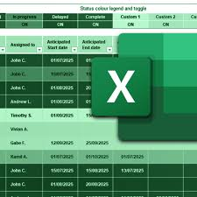
Data Collection
• Employment and unemployment statistics
• Job postings and labor market surveys
• Training and education program data

Slide 6
Excel – Data Cleaning & Preprocessing
• Removed duplicates & blanks
• Handled outliers
• Standardized Department, Region, Skills

Slide 7
Excel – Feature Engineering
Years Experience (CATEGORICAL VALUE)
Skill score (CATEGORICAL VALUE)
Performance Rating(CATEGORICAL VALUE)
Start Date(CATEGORICAL VALUE)
End Date(CATEGORICAL VALUE)
Skill Improvement Score(CATEGORICAL VALUE)
Posted Date(CATEGORICAL VALUE)

Slide 8

SQL – Data Analysis
Region-wise Employee Count
Department wise Avg(Skill Score)
Job Demand (Vacancy) in Industry
Job Title vs. Employee Skill Score
Training Effectiveness (Skill Improvement Score Average)
Region-wise Job & Employee Availability Comparison
Which Employees Are Underqualified for their Job
Employee Salary vs Job Salary Range Mismatch
Most Popular Training Programs (Highest Enrollments)
Industry-wise Average Experience
openings(vacancy) vs skill
High demand but low supply sector

Slide 9
SQL - Queries Used
• GROUP BY Department, Region
• AVG(Skill Score)
• SUM(Vacancies)
• Demand vs Supply comparison

Slide 10
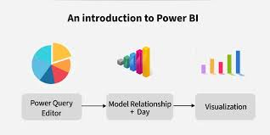
Power BI – Data Modeling
• Imported ETL file
• Created relationships
• Built measures (DAX)

Slide 11
Power BI Dashboard – Key Analysis
Training Effectiveness
High Demand vs Low supply
Vacancy in Industry
Vacancy and Availability of Employees
Vacancy vs Skill Score

Slide 12
Power Bi - Visuals Used
Line Chart
Bar Chart
Scatter Plot
KPI
Slicers

Slide 13
Insights
• Some departments show high vacancies but low skill scores
• Regional imbalance in workforce
• Training improves skill score but unevenly

Slide 14
Recommendations
• Targeted upskilling programs
• Industry-aligned training
• Region-specific hiring plans

Slide 15
Conclusion
This project successfully demonstrates how employment data analysis can be used to identify existing and emerging skill gaps in the workforce. By analyzing employment statistics, job postings, and training program data, the study highlights the mismatch between industry skill demand and workforce skill availability.
The use of Excel and SQL enabled effective data cleaning, preprocessing, and analysis, while Power BI provided meaningful visualizations through interactive dashboards. These dashboards make it easier for stakeholders to understand trends, regional differences, and sector-wise skill shortages.
Overall, this project proves that data-driven insights can play a crucial role in aligning education and training systems with labor market needs, supporting informed decision-making for policymakers, educators, and employers.

